Slide 1
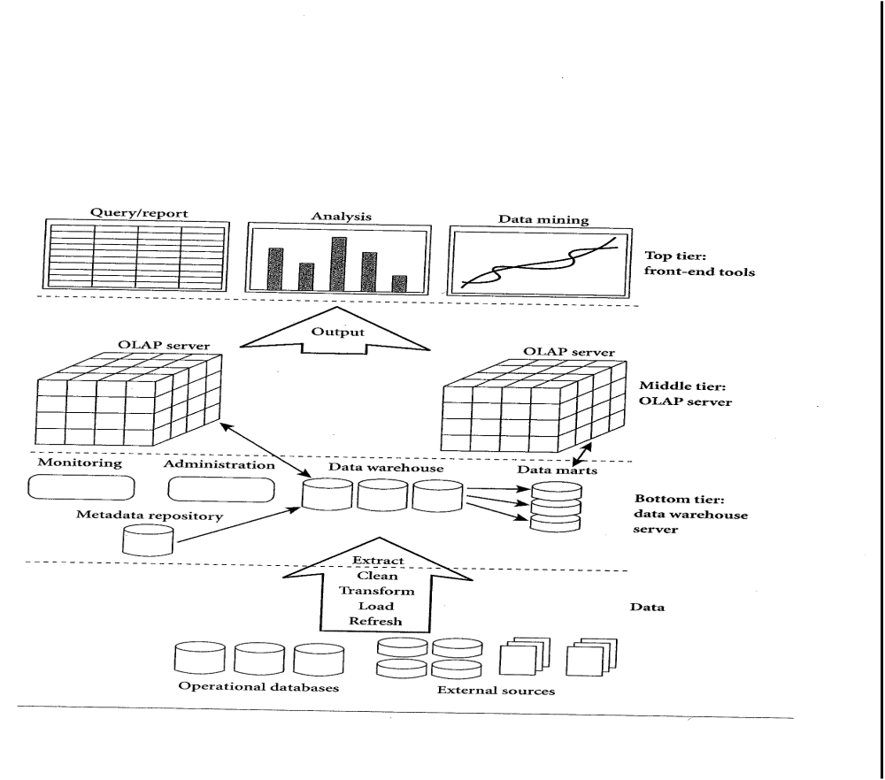
OLAP (Online Analytical Processing)

Slide 2
Data Warehouse
A data warehouse is a subject-oriented, integrated, time-variant, and nonvolatile collection of data in support of management’s decision-making process.

Slide 3
Online Analytical Processing
An OLAP system manages large amount of historical data, provides facilities for summarization and aggregation, and stores and manages information at different levels of granularity.

Slide 4
Why Separate Data Warehouse?
High performance for both systems
  DBMS— tuned for OLTP: access methods, indexing, concurrency control, recovery
  Warehouse—tuned for OLAP: complex OLAP queries, multidimensional view, consolidation.
Different functions and different data:
  missing data: Decision support requires historical data which operational DBs do not typically maintain
  data consolidation: DS requires consolidation (aggregation, summarization) of data from heterogeneous sources
  data quality: different sources typically use inconsistent data representations, codes and formats which have to be reconciled

Slide 5
From Tables and Spreadsheets to Data Cubes
A data warehouse is based on a multidimensional data model which views data in the form of a data cube.
A data cube, such as sales, allows data to be modeled and viewed in multiple dimensions
In data warehousing literature, an n-D base cube is called a base cuboid. The top most 0-D cuboid, which holds the highest-level of summarization, is called the apex cuboid. The lattice of cuboids forms a data cube.

Slide 6

OLTP vs. OLAP

Slide 7
OLAP Server Architectures
Relational OLAP (ROLAP):
  Use relational or extended-relational DBMS to store and manage warehouse data and OLAP middle ware to support missing pieces.
  Include optimization of DBMS backend, implementation of aggregation navigation logic, and additional tools and services
  greater scalability
Multidimensional OLAP (MOLAP):
  Array-based multidimensional storage engine (sparse matrix techniques)
  fast indexing to pre-computed summarized data
Hybrid OLAP (HOLAP):
  User flexibility, e.g., low level: relational, high-level: array.
Specialized SQL servers:
  specialized support for SQL queries over star.snowflake schemas

Slide 8
Multidimensional Data
Sales volume as a function of product, month, and region
Dimensions: Product, Location, Time
Hierarchical summarization paths
Region
Industry Region Year
Category Country Quarter
Product City Month Week
Office Day
Product
Month

Slide 9
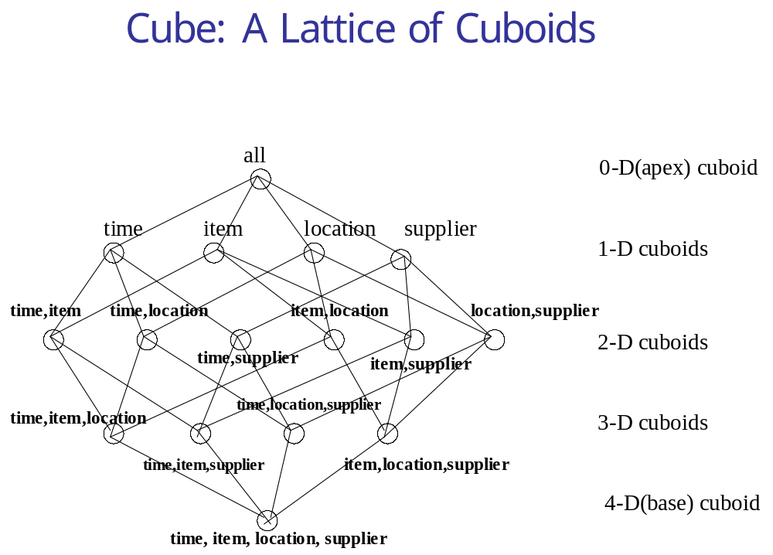

Slide 10
Typical OLAP Operations
Roll up (drill-up): summarize data
  by climbing up hierarchy or by dimension reduction
Drill down (roll down): reverse of roll-up
  from higher level summary to lower level summary or detailed data, or introducing new dimensions
Slice and dice:
  project and select
Pivot (rotate):
  reorient the cube, visualization, 3D to series of 2D planes.
Other operations
  drill through: through the bottom level of the cube to its back-end relational tables (using SQL)

Slide 11
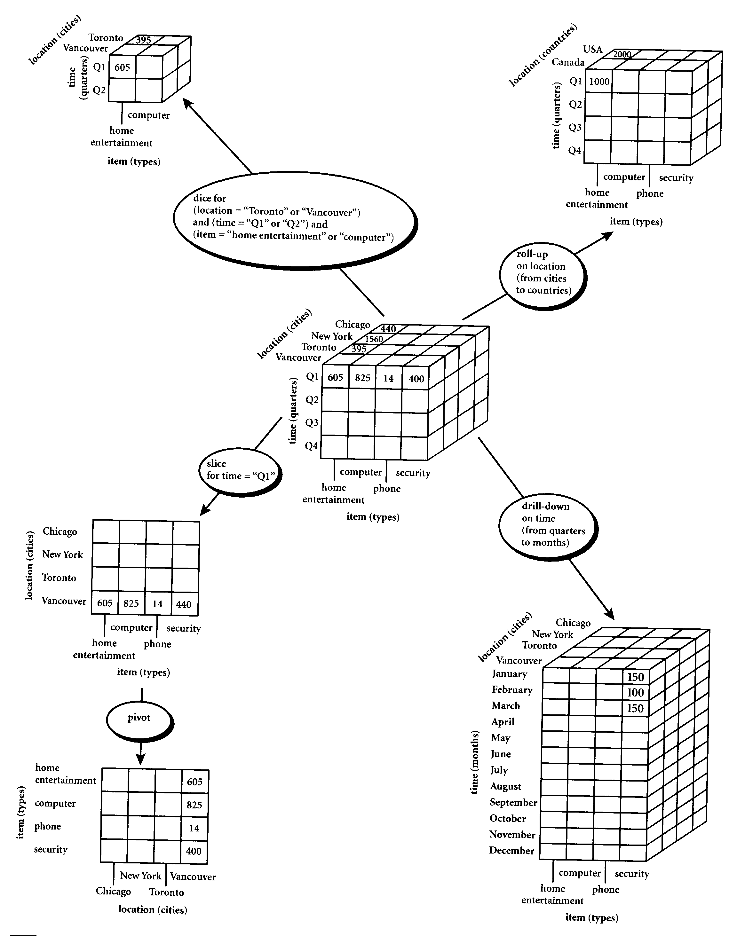

Slide 12
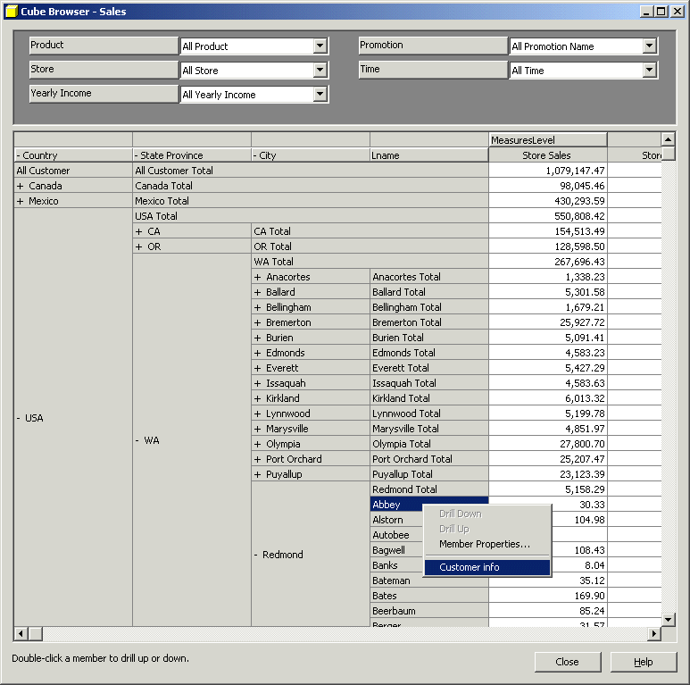
Sample
OLAP Drill down online report

Slide 13
Cube Operation
Cube definition and computation in OLAP
    define cube sales[item, city, year]: sum(sales_in_dollars)
    compute cube sales
Transform it into a SQL-like language (with a new operator cube by)
    SELECT item, city, year, SUM (amount)
    FROM SALES
    CUBE BY item, city, year
Need compute the following Group-Bys
    (date, product, customer),
    (date,product),(date, customer), (product, customer),
    (date), (product), (customer)
    ()
()
(city)
(item)
(year)
(city, item)
(city, year)
(item, year)
(city, item, year)

Slide 14
Roll-up and Drill-down
The roll-up operation performs aggregation on a data cube, either by climbing up a concept hierarchy for a dimension or by dimension reduction such that one or more dimensions are removed from the given cube.
Drill-down is the reverse of roll-up. It navigates from less detailed data to more detailed data. Drill-down can be realized by either stepping down a concept hierarchy for a dimension or introducing additional dimensions.

Slide 15
Slice and dice
The slice operation performs a selection on one dimension of the given cube, resulting in a sub_cube.
The dice operation defines a sub_cube by performing a selection on two or more dimensions.

Slide 16
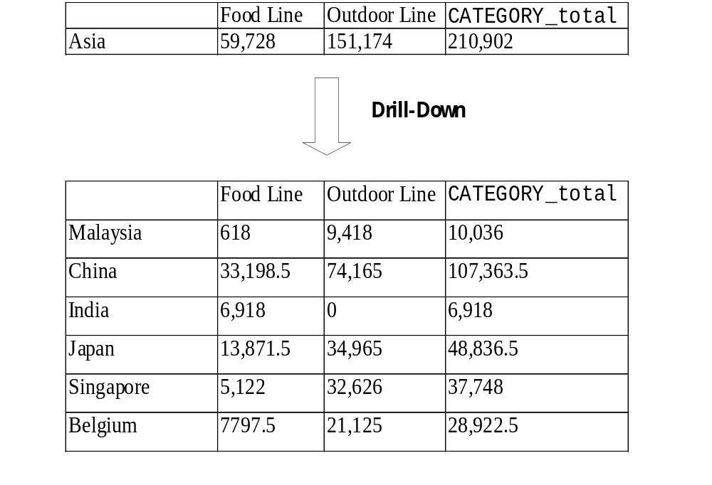

Slide 17
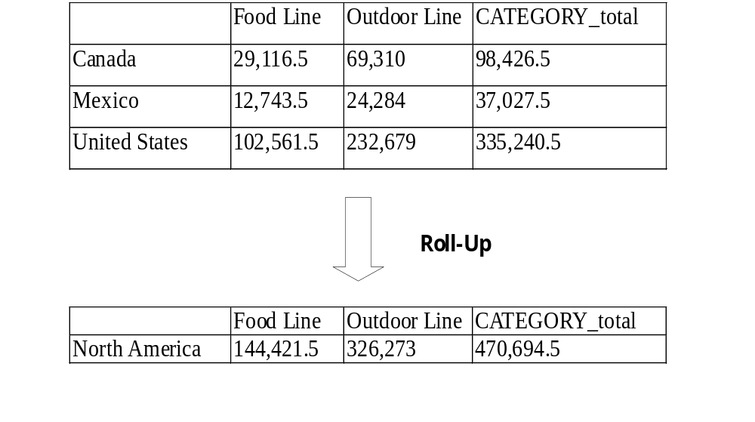

Slide 18
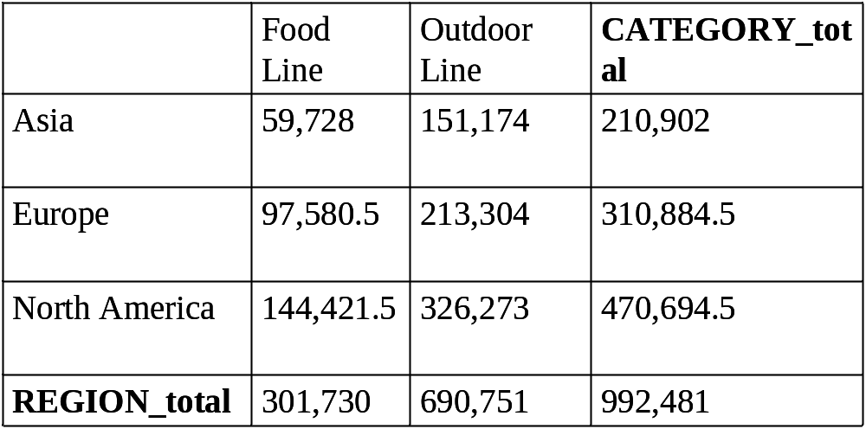
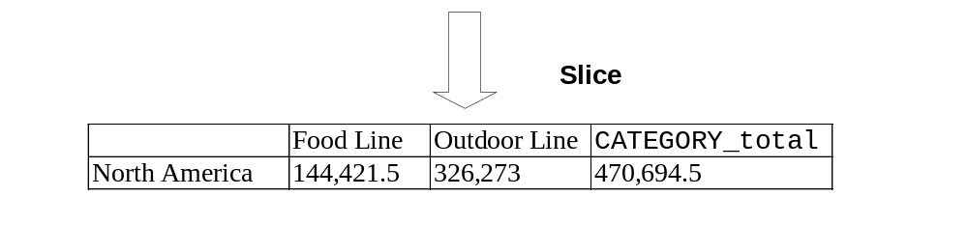

Slide 19
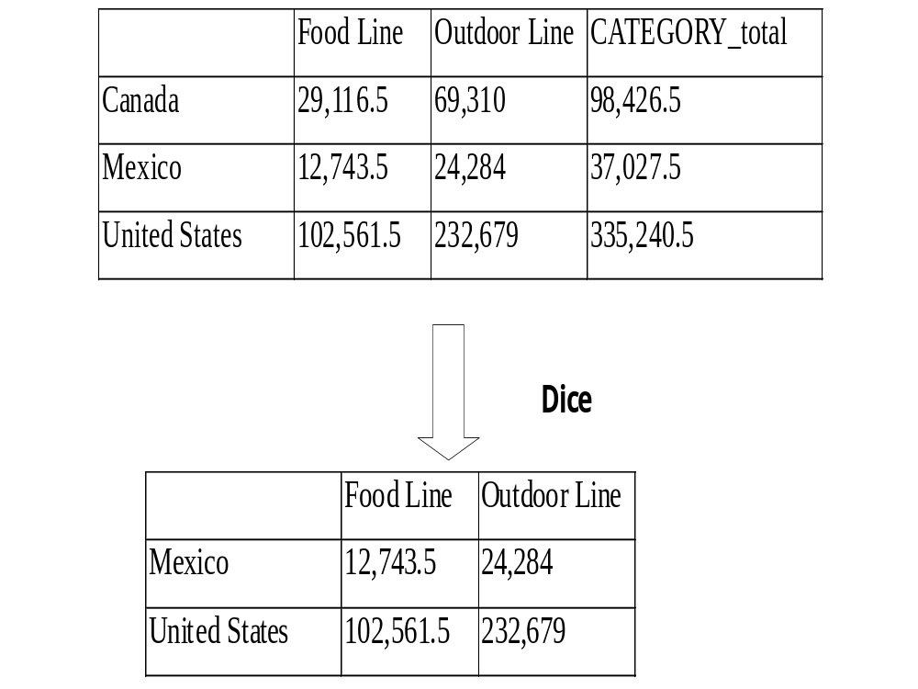

Slide 20
Querying with MDX
(Multidimensional Expressions)
The select clause defines axis dimensions on COLUMNS and on ROWS, where clause supplies slicer dimensions, and Cube is the name of the data cube.
Select axis [, axis]
From Cube
Where slicer [, slicer]

Slide 21
The Data Hierarchy
For the majority of MDX statements, the context of the query will be limited to a single cube. It is important to know how all data within a cube is divided into the following relationship:
Dimensions
Hierarchies
Levels
Members

Slide 22
Sample MDX where italic are default
SELECT
{[Gender].[Gender].Members} ON COLUMNS,
{[Product].[Product Family].Members} ON ROWS,
FROM [Sales]
WHERE
([Measures].[Unit Sales],
[Customers].[All Customers],
[Education Level].[All Education Level],
[Marital Status].[All Martial status],
[Promotions].[All Promotions],
[Store].[All Stores],
[Store Size in SQFT].[All],
[Store Type].[All],
[Yearly Income].[All Yearly Income]

Slide 23
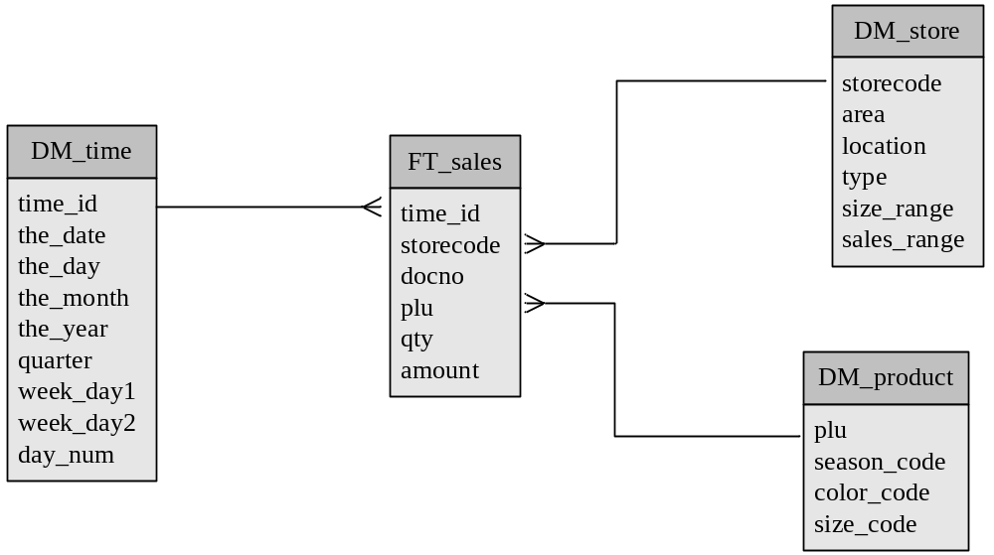
Example on Star Schema

Slide 24
Example on Roll-up
MDX
SELECT [SALES].[AMOUNT] ON COLUMNS,
[store].[Kowloon] ON ROWS
FROM SALES
SQL
select sum(amount), area
from SALES
where (area='Kowloon') group by area

Slide 25
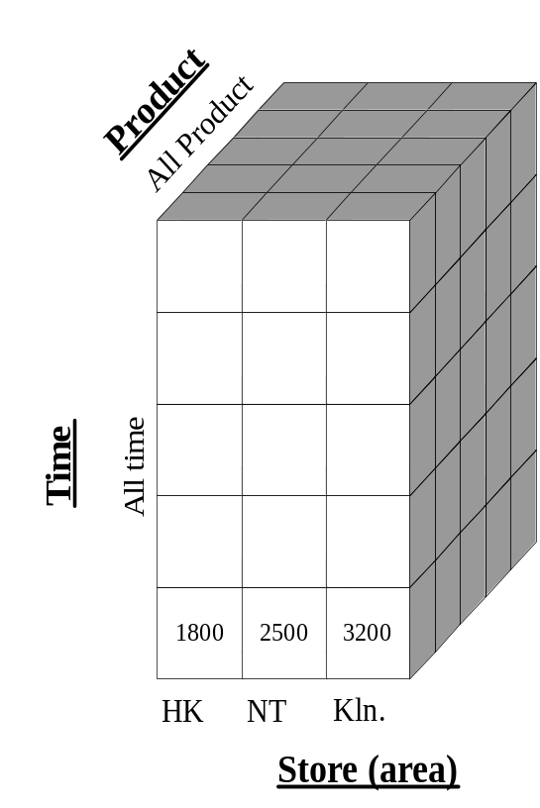
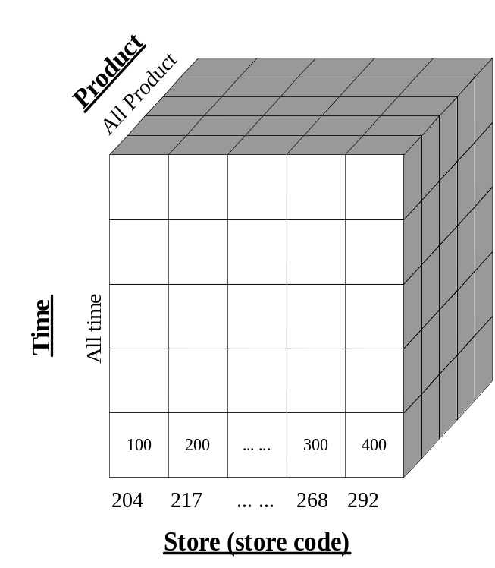
Graphical Description on Roll-up Example
Roll-up
on Store Dimension
(from store to area)
Store is the child of Area

Slide 26
Example on Drill-down
MDX
SELECT [SALES].[AMOUNT] ON COLUMNS,
[time].[2003].[Q4].[Dec].[31],
[time].[2003].[Q4].[Dec].[30],… …,
[time].[2003].[Q4].[Dec].[2],
[time].[2003].[Q4].[Dec].[1] ON ROWS FROM SALES
SQL
select sum(amount), the_date
from SALES
where (the_date='2003-Dec-31')
or (the_date='2003-Dec-30')
or… …or (the_date='2003-Dec-2')
or (the_date='2003-Dec-1') group by the_date

Slide 27
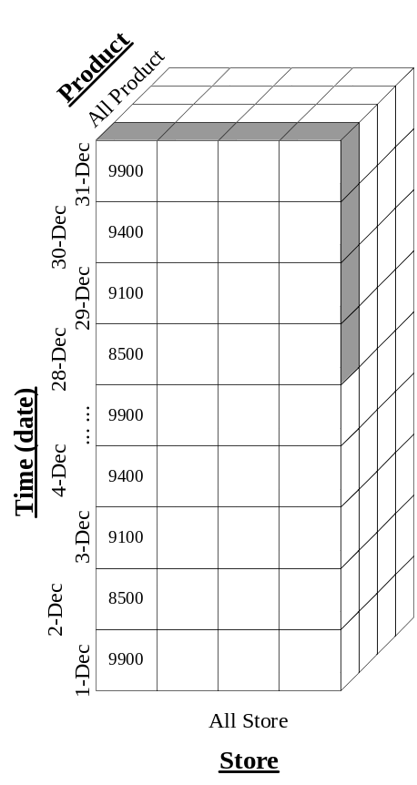
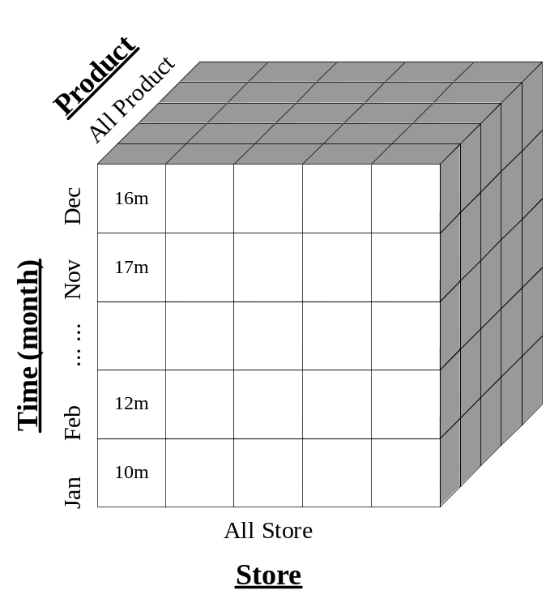
Graphical Description of Drill-down Example
Drill-down
on Time Dimension
(from month to date)
Month is the parent of Date

Slide 28
Example on Slice
MDX
SELECT [SALES].[AMOUNT] ON COLUMNS,
[store].[Kowloon].[292] ON ROWS FROM SALES
SQL
select sum(amount), storecode
from SALES
where (storecode='292') group by storecode

Slide 29
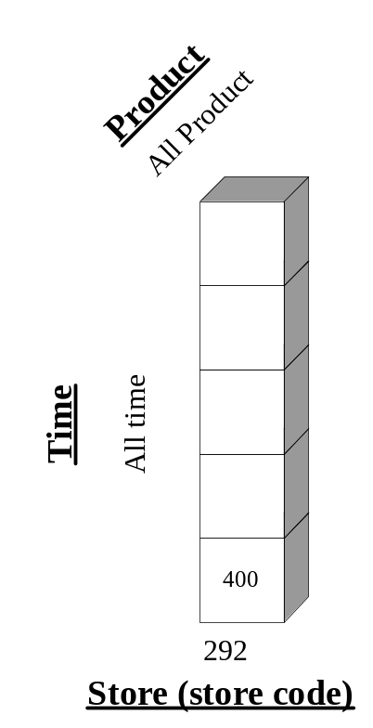
Graphical Description of Slice
Slice
WHERE store = ‘292’

Slide 30
Example on Dice
MDX
SELECT [SALES].[AMOUNT] ON COLUMNS,
[store].[HK],[store].[NT], [store].[Kowloon] ON ROWS
FROM SALES WHERE [time].[2003].[Q4].[Dec].[24]
SQL
select sum(amount), area
from SALES
where ( (area='HK') or (area='NT') or (area='Kowloon'))
and (the_date='2003-Dec-24')
group by area

Slide 31
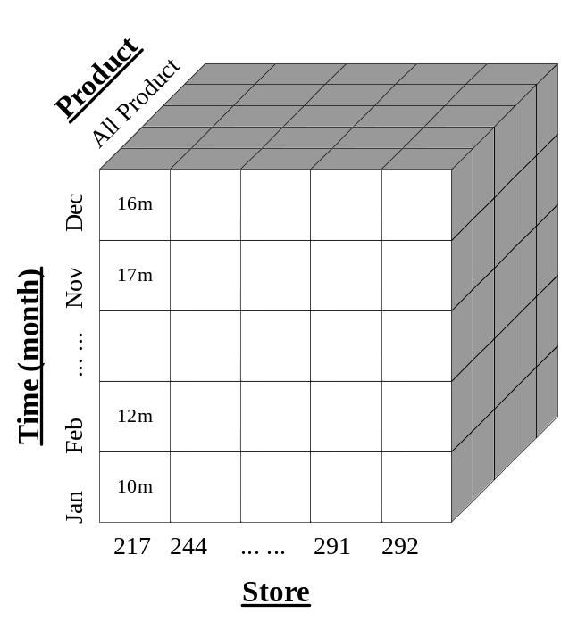
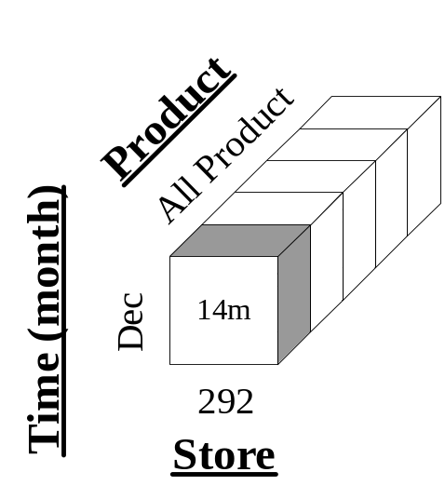
Graphical Description of Dice
Dice
WHERE (store = ‘292’) and (time = ‘Dec’) and product = ‘ALL’

Slide 32
The CrossJoin ( ) Function
The CrossJoin ( ) function is used to generate the cross-product of two input sets. If two sets exist in two independent dimensions, the CrossJoin operator creates a new set consisting of all of the combinations of the members in the two dimensions.

Slide 33
Filter ( ) Versus Slicer
In some respects, the Filter ( ) function and the slicer axis have similar purposes. The difference between the two is that the Filter ( ) function defines the members in a set, while slicers determine a slice of the cube returned from a query.

Slide 34
The Order ( ) Function
The Order ( ) function provides sorting capabilities within the MDX language. When the Order expression is used, it can either sort within the natural hierarchy (ASC and BDESC), or it can sort without the hierarchy (BASC and BDESC). The “B” indicates “break” hierachy.

Slide 35
TopCount ( ) and BottomCount ( ) Functions
The TopCount () and BottomCount() functions provide rank functionality critical in a decision support and data analysis environment. These expressions sort a set based on a numerical expression and pick the top index items based on rank order.

Slide 36
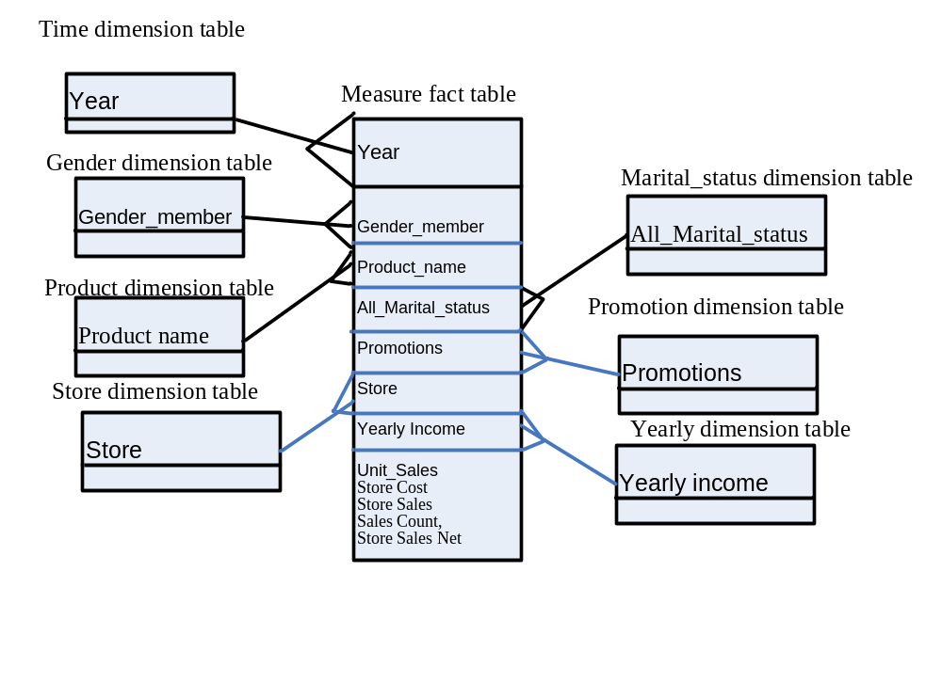
Sales Data Warehouse Star Schema of the SalesRecord

Slide 37
Sample Star Schema of Sales Record
Dimension tables:
[Gender].[Gender Members]
[Product].[Product Name]
[Marital Status].[All Martial status]
[Promotions].[All Promotions],
[Store].[All Stores],
[Store Size in SQFT].[All],
[Store Type].[All],
[Yearly Income].[All Yearly Income]
[Time].[Year]
Fact table:
[Measures].[Unit Sales],
[Measures].[Store Cost],
[Measures].[Store Sales],
[Measures].[Sales Count],
[Measures].[Store Sales Net]

Slide 38
Axis Dimensions in the Select Clause
Select
CrossJoin({[Gender]. [Gender]. Members},
{[Time].[Year]. Members}) ON COLUMNS,
{[Measures].Members} ON ROWS
FROM [Sales]
Where CrossJoin operator of source sets creates a new set consisting of all of the combinations of the members of the source sets.

Slide 39
This query crossjoins the Gender and the Time dimensions to produce data in which the data for each gender is broken into two years in this cube.
The two specific sets that are within the CrossJoin are the two members of the gender level of the Gender dimension, and the two years in the year level of the Time dimension.
The set of all members of the Measure dimension is included on the rows axis.
There is no member explicitly added as a slicer in this query.

Slide 40
Output from the data cube of Slicer Function
F
M
 | 1997 | 1998 | 1997 | 1998
Unit Sales | 131,558.00 |  | 135,215.00
Store Cost | 111,777.48 |  | 113,849.75
Store Sales | 280,228.21 |  | 285,011.92
Sales count | 428.31 |  | 440.06
Store Sales Net | 168,448.73 |  | 171,162.17

Slide 41
Filter filers a set based on a particular condition
SELECT
{[Measures]. [Unit Sales]} ON COLUMNS,
{Filter({[Product]. [Product Department].Members},
([Gender]. [All Gender].[F],[Measures].[Unit Sales]) > 10000)} ON ROWS
FROM [Sales]

Slide 42
The Filter function produces a set of product departments meeting the Filter criteria
The results of this query show that the set returned on the rows axis consists of product departments for which unit sales to females is greater than $10000

Slide 43
Output from the data cube
 | Unit Sales
Frozen Food | 26,655.00
Produce | 37,792.00
Snack Foods | 30,545.00
Household | 27,038.00

Slide 44
TopCount( ) and BottomCount( ) Functions
SELECT
{[Customers].[All Customers].[USA],
[Customers].[All Customers].[USA].Children}ON COLUMNS,
{TopCount({[Product].[Product Category].Members},
5, [Measures].[Unit Sales]),
BottomCount({[Product].[Product Category].Members},
5, [Measures].[Unit Sales])} ON ROWS
FROM [Sales]
Where TopCount is to request the highest count of the data as a result of the query. Similarly, BottomCount is to request the lowest count of the data as a result of the query.

Slide 45
The columns axis contains the members from the customers dimension. The single member, {[Customers].[All Customers].[USA] is specified and the children of USA, [Customers].[All Customers].[USA]. Children, are combined in a comma- separated list to make up the set.
The product categories are included on the rows axis in a comma-separated list where different operators are used to specify a particular subset of the [Product].[Product Category]. Members set. Unit sales is used as the measure with which to select the top five product categories and the bottom five product categories.

Slide 46
Output from the data cube
 | USA | CA | OR | WA
Snack Foods | 30,545.00 | 8,543.00 | 7,789.00 | 14,213.00
Vegetables | 20,733.00 | 5,506.00 | 5,447.00 | 9,306.00
Dairy | 12,885.00 | 3,534.00 | 3,131.00 | 6,220.00
Jams & Jelies | 11,888.00 | 3,343.00 | 2,877.00 | 5,868.00
Fruit | 11,767.00 | 3,184.00 | 3,008.00 | 5,575.00
Canned Oysters | 708.00 | 220.00 | 182.00 | 296.00
Canned Shimp | 804.00 | 231.00 | 173.00 | 400.00
Hardware | 810.00 | 281.00 | 215.00 | 334.00
Candies | 815.00 | 286.00 | 248.00 | 303.00
Canned Food | 819.00 | 234.00 | 215.00 | 370.00

Slide 47
The Order () Function
Select
{[Marital Status].[All Marital Status].[S]} ON COLUMNS,
{Order ({[Promotion Media].[Media Type].Members},
[Unit Sales], BDESC)} ON ROWS
FROM [Sales]
Where BDESC means sort descending without hierarchy.

Slide 48
The Order function provides sorting capabilities within the MDX language in ASC, DESC, BASC and BDESC where “B” indicates “break” hierarchy.
The sort was performed using the [Marital Status] .[All Marital Status].[S] member in descending order without hierarchy of the unit sales.

Slide 49
Output from the data cube
Marital Status | S
No Media | 95.970.00
Daily Paper, Radio, TV | 4,787.00
Daily Paper | 3,559.00
Product Attachment | 3,352.00
Daily Paper, Radio | 3,572.00
Cash Register Handout | 3,567.00
Sunday Paper, Radio | 3,285.00
Street Handout | 2,921.00
Sunday Paper | 2,098.00
Bulk Mail | 2,271.00
In Store Coupon | 1,829.00
TV | 1,873.00
Sunday Paper, Radio, TV | 1,378.00
Radio | 1,298.00

Slide 50
Filter Function
Select
{[Gender], Members} ON COLUMNS,
{TopCount ({[Product].[Product Name].Members},10,
([Gender].[Gender].[F], [Measures].[Unit Sales]))} ON ROWS
FROM [Sales]
WHERE ([Marital Status].[All Marital Status].[M],
[Measures].[Unit Sales])

Slide 51
This query is motivated by a desire to determine which products married women are most likely to purchase and the sales of these same products to married men.
The columns axis contains all members of the gender dimension, [All Gender], [F]. and [M]. [All Gender] is included because the .Members function was placed on the gender dimension instead of on the [Gender].[Gender] level.
The fundamental set in the rows axis consists of names of products (members of the [Product].[Product Name] level). In this query the TopCount ( ) function is used to examine some of the products. Of specific interest here are the top 10 products in unit sales pruchased by females. Therefore, the index in the TopCount ( ) function is 10, and the numeric expression is the tuple ([Gender].[Gender].[F], [Measures].[Unit Sales]).
The slicer contains the two members explicitly defined, [Marital Status].[All Marital Status].[M] and [Measures].[Unit Sales], because only data with these characteristics is desired.

Slide 52
Output from the data cube
 | All Gender | F | M
Fabulous Berry Juice | 127.00 | 87.00 | 40.00
Fast Beef Jerky | 134.00 | 87.00 | 47.00
BBB Best Pepper | 134.00 | 82.00 | 52.00
Ebony Cantelope | 130.00 | 80.00 | 50.00
Peart Cheable Wine | 117.00 | 79.00 | 38.00
Skinner Diel Cola | 115.00 | 78.00 | 37.00
Shdy Lake Manicotti | 106.00 | 78.00 | 28.00
Pearl Light Beer | 130.00 | 77.00 | 53.00
Shady Lake Rice Medly | 131.00 | 77.00 | 54.00
TriState Potatos | 108.00 | 76.00 | 32.00

Slide 53
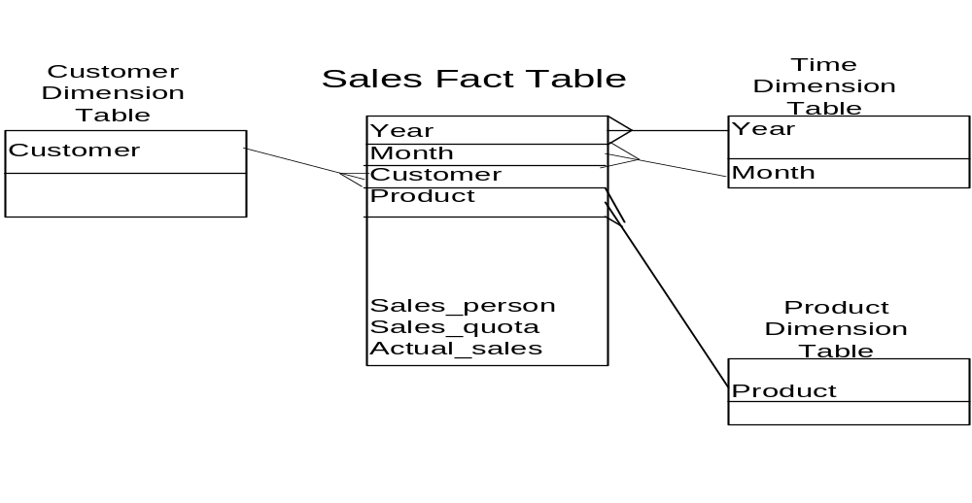
Example of OLAP
Starting with the base cuboid [Year, Month, Customer, Product, Sales-person, Sales-quota, Actual-sales], what specific OLAP operation should be performed in order to list the total Actual Sales by Customer in year 2000?
The requested SQL statement is:
Select Customer, Sum(Actual_sales) From Sales Where year = ‘2000’ Group by customer
The requested MDX statement is:
Select{[Sales].Actual_sales}on Columns
({[Customer].Customer_name},{[Time].Year}) on Rows
from Cuboid
Where ([Time].[Year].[2000])

Slide 54
Reading assignment
“Data Mining: Concepts and Techniques” Second edition by Han and Kamber, Morgan Kaufmann publishers, 2007, chapter 3, pp. 123-154.

Slide 55
Lecture review question 5
Discuss three methods of implementing an online analytical processing command. Give an example of using one of them with a given Star schema.

Slide 56
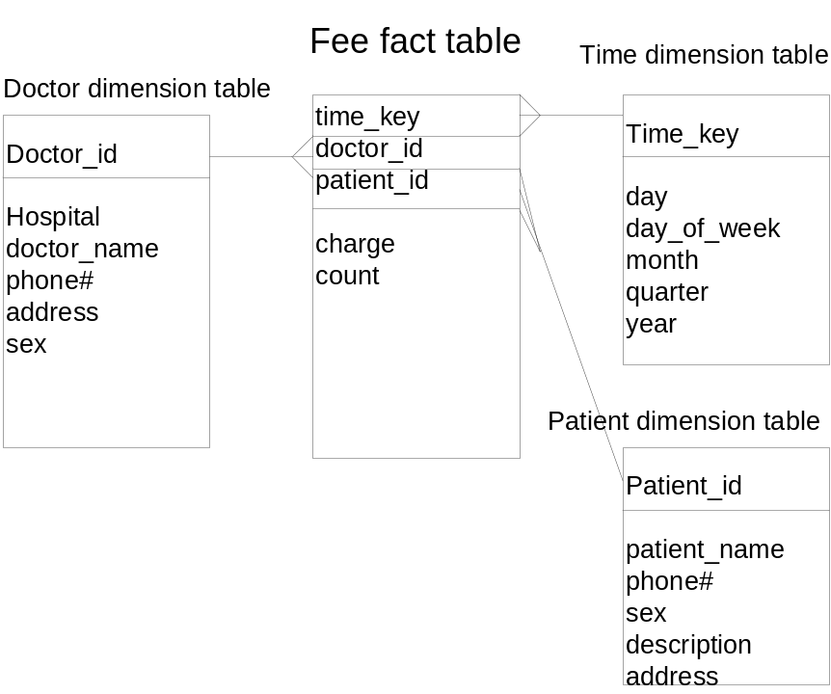
Tutorial Question 5
Suppose that a data warehouse consists of the three dimensions time, doctor, and patent, and the two measures count and charge, where charge is the fee that a doctor charges a patient for a visit. Starting with the base cuboid [day, doctor, patient], provide a MDX (Multidimensional Expression) query to list the total fee collected by each doctor in 2000?
To obtain the same list, write an SQL query assuming the data is stored in a relational database with the table fee (day, month, year, doctor, hospital, patient, count, charge).
Starting with the base cuboid [day, doctor, patient], provide a MDX (Multidimensional Expression) query to list the total fee collected by each doctor in 2000?
To obtain the same list, write an SQL query assuming the data is stored in a relational database with the table fee (day, month, year, doctor, hospital, patient, count, charge).

